Slide 1
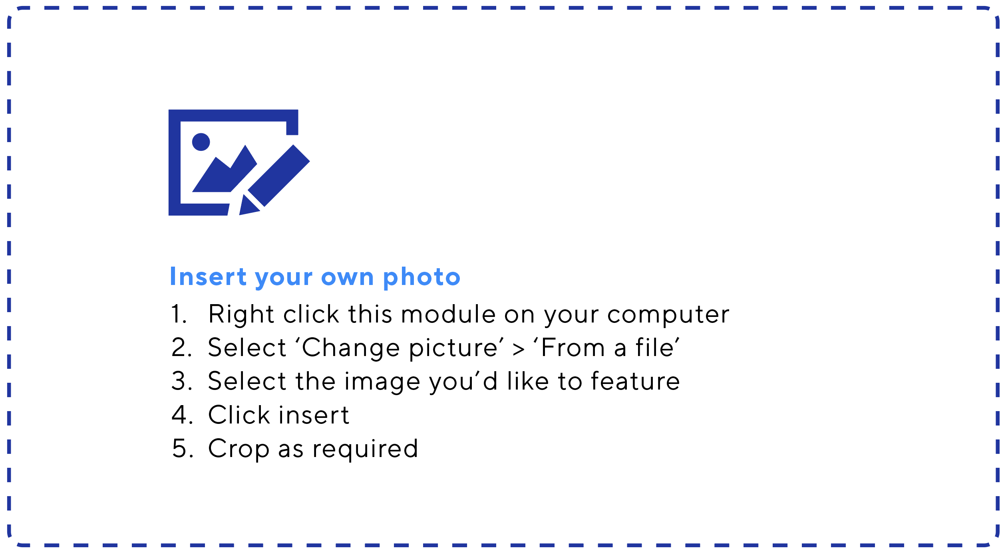
Printing
Once you’ve completed your poster. Simply click file >print.
To print the poster at different sizes, simply select ‘scale to fit paper’. For additional print options, save as PDF then print.
Inserting a QR code to
your fundraising page.
Login to your dashboard and download your
QR code from the
‘Get Support’ menu.
Drag your new QR code on top of the code already displayed on this poster.

